Slide 1




GEMOC Studio Tutorial
ICSA Conference, April, 2017
Barais, Combemale, Vojtisek, Wortmann
Inria & Univ. Rennes 1
http://diverse.irisa.fr/

Slide 2
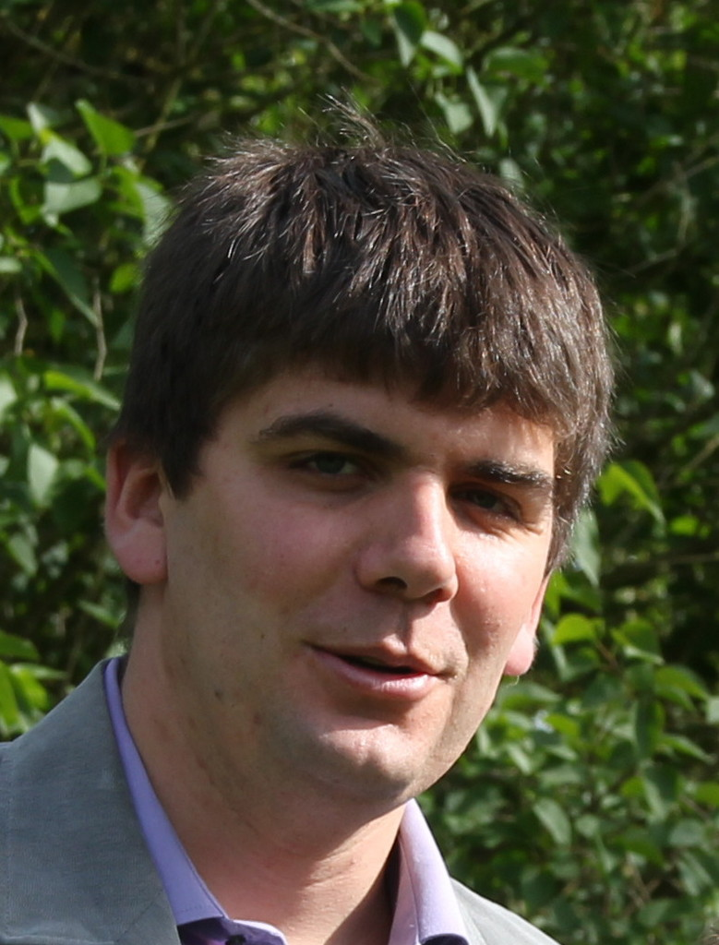



People
Olivier Barais Inria & Univ. Rennes 1 | Benoit Combemale Inria & Univ. Rennes 1 | Didier Vojtisek Inria | Andreas Wortmann Inria & Univ. Rennes 1 RWTH Aachen

Slide 3
"Software languages are software too"
J-M. Favre, D. Gasevic, R. Lämmel, and E. Pek. "Empirical language analysis in software linguistics," In Software Language Engineering, volume 6563 of LNCS, pages 316–326. Springer, 2011.

Slide 4


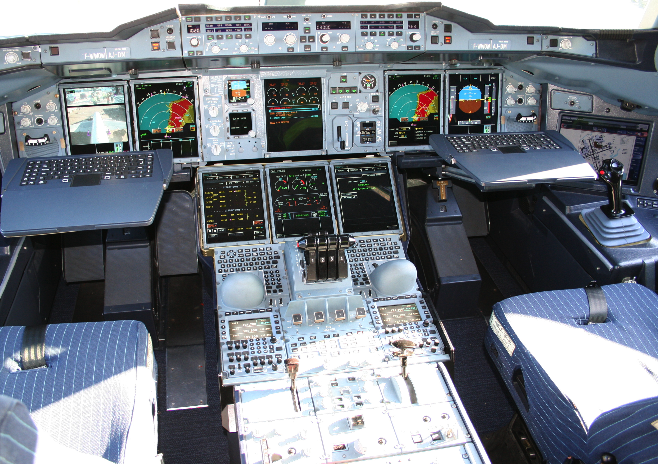









Mechanical
Structure
Airlines
Human-Machine Interaction
Avionics
Multiple
Concerns
Aerodynamics
Environmental
Impact
Propulsion
System
Safety
Regulations
Communications
Authorities
Navigation
Notes:
This piece of complex software integrates different perspectives from these stakeholders
Physics, communications, Pilots -> HCI

Slide 5
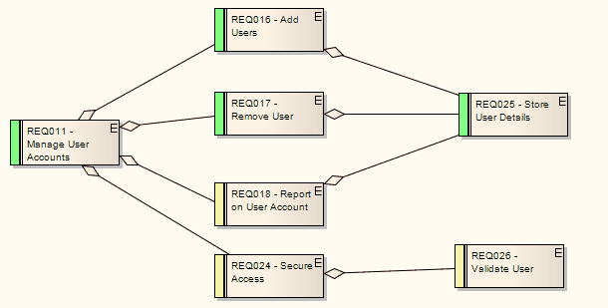
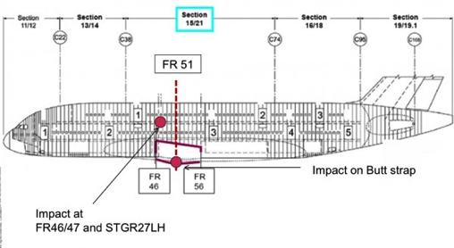
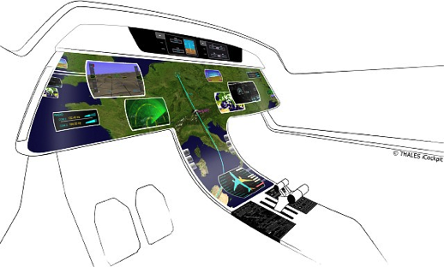
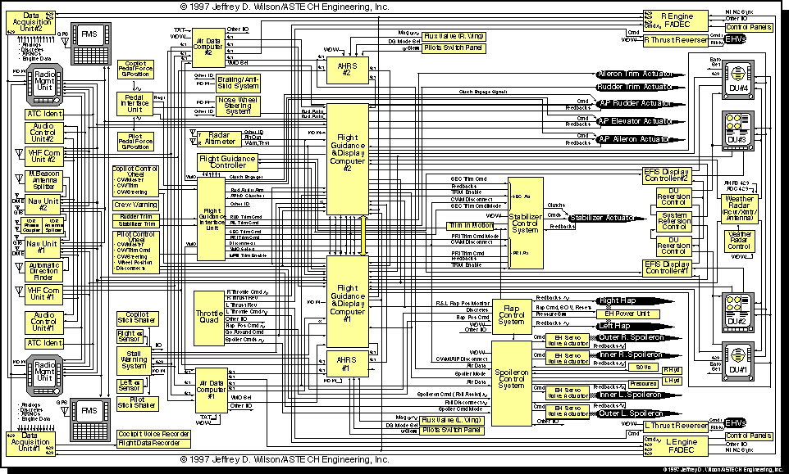
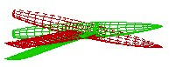
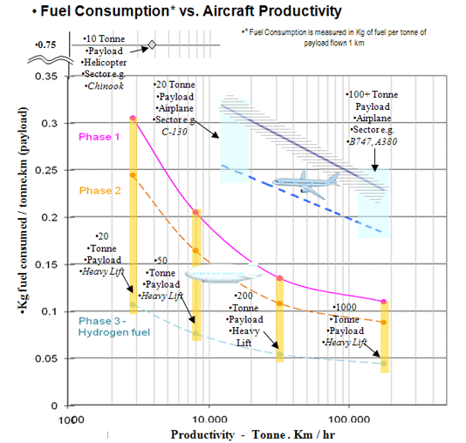
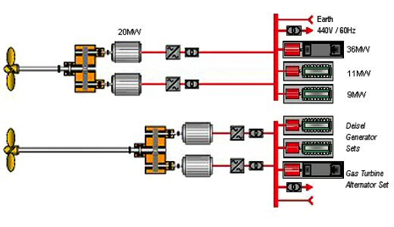
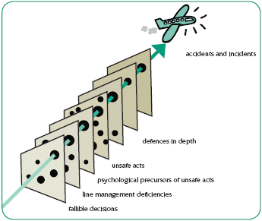
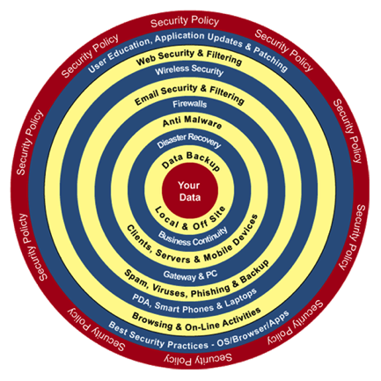
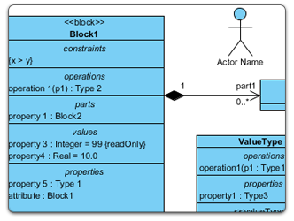
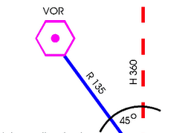
Mechanical
Structure
Airlines
Human-Machine Interaction
Avionics
Heterogeneous Modeling
Aerodynamics
Environmental
Impact
Propulsion
System
Safety
Regulations
Communications
Authorities
Navigation
Notes:
Parler ici du positionnement avec la co-simulation

Slide 6

GEMOC initiative
An open and international initiative to
foster globalization of DSMLs in open world
impossible a priori unification
require a posteriori globalization
coordinate (between members) and disseminate (for the members)
Organizes
workshop series
Dagstuhl and Bellairs seminars
http://gemoc.org @gemocinitiative

Slide 7



GEMOC studio
http://gemoc.org/studio
Language
Workbench
Modeling
Workbench
Design and compose your executable DSMLs
Edit and debug
your heterogeneous models

Slide 8
This tutorial
See how EMF+GEMOC technologies help to (semi-automatically) build the tooling for a DSL IDE
Extend a DSL: structure and behavior
Lectures and hands-on sessions using FSM and XMontiArc
Combine both DSLs
Materials are available from https://github.com/gemoc/ICSA2017Tutorial

Slide 9


Course content
Part 1. General introduction
Modeling and Languages
Part 2. Language Engineering
Teaser: FSM Example
Metamodeling: Ecore OCL
Syntax: Sirius
Dynamics: K3/Melange
DSL Composition
Part 3. Wrap-up and Discussion
Coordination

Slide 10
You will learn how to
Automatically translate abstract design models to executable code, test cases and documentation
Automatically manipulate your model/code to analyze and refactor it
Build or customize your own abstractions, or even software languages and development environments, to build complex, domain-specific, software-intensive systems
Eventually limit the accidental complexity of industrial processes developments
Apply language formalisms, paradigms and principles (Grammar vs 'Meta'-models)
Manage the industrial complexity of developments and associated toolchains

Slide 11
A few notes on the tutorial
We plan with ca. 90 minutes presentations on concerns and technologies and ca. 90 minutes hands-on time
Creating a sufficiently interesting, yet full-blown, modeling language including syntax, semantics, and editors in 90 minutes is challenging to impossible
To introduce the quintessential aspects of language engineering to you we will ask you to clear your workspace and download different stages of the involved languages. Please look out for the following symbol: on the tutorial website https://github.com/gemoc/ICSA2017Tutorial

Slide 12
Today’s program
14:00 Presentation: Opening
14:15 Presentation: GEMOC Initiative and Studio
14:45 Presentation: Model Execution
15:00 Hands-On: Setup and Model Execution
15:10 Presentation: Metamodeling
15:30 Coffee Break
16:00 Presentation: Concrete Syntax
16:15 Hands-On: Create Graphical Representation
16:35 Presentation: MontiArc and Language Composition
16:50 Hands-On: Composing FSM and MontiArc
17:15 Summary, Discussion

Slide 13
LANGUAGE ENGINEERING
PART 2

Slide 14
What is a language?
“A system of signs, symbols, gestures, or rules used in communication”
The special vocabulary and usages of a scientific, professional, or other group”
“A system of symbols and rules used for communication with or between computers”
“The words, their pronunciation, and the methods of combining them used and understood by a community”

Slide 15
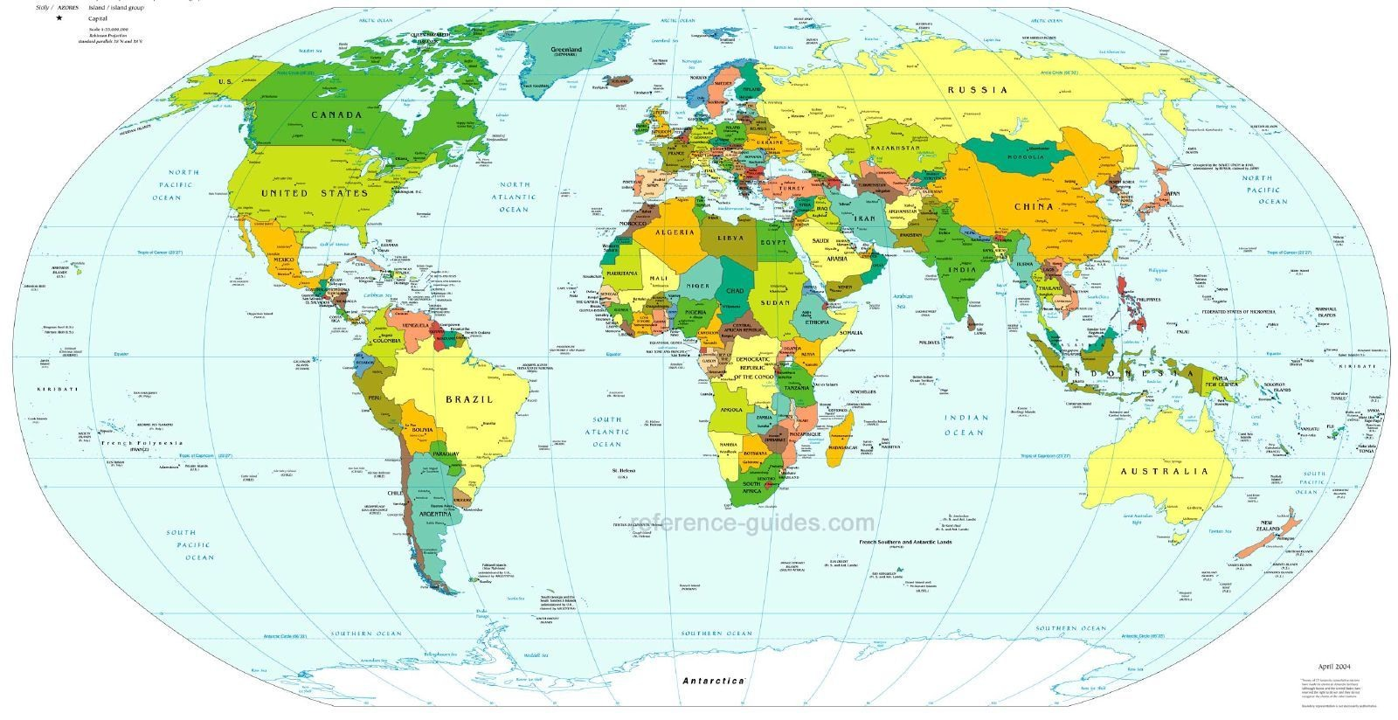
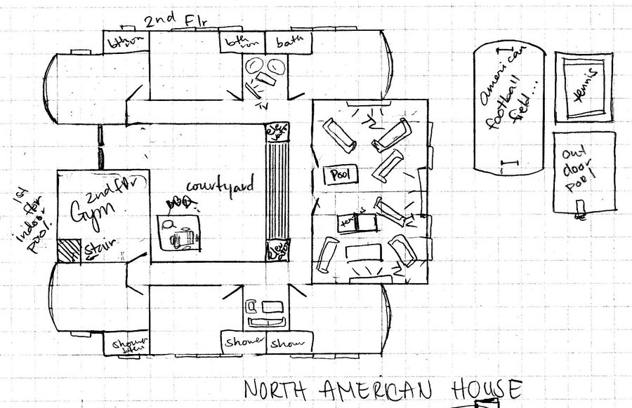
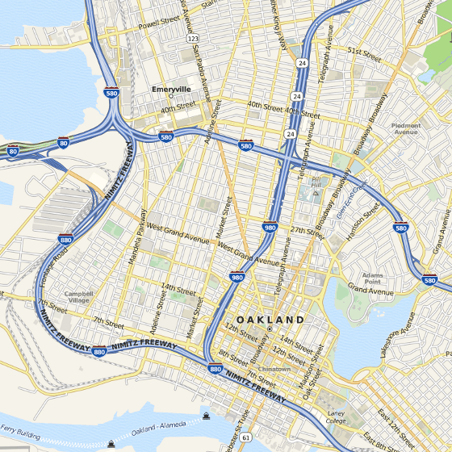
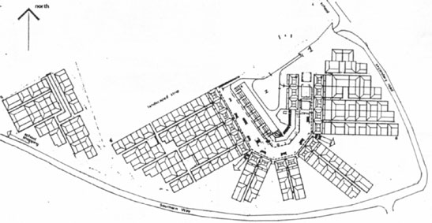
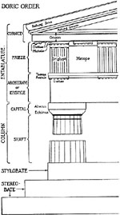
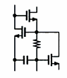
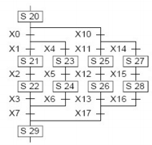
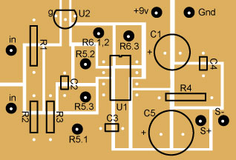
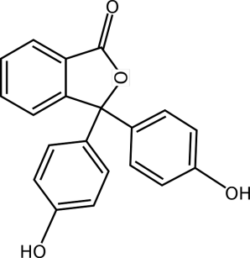
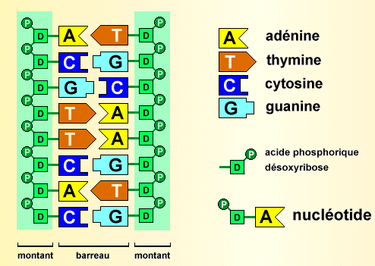
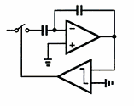
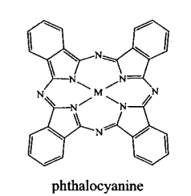
Languages in various domains
Cartography
Architecture
Electronics
Biology

Slide 16
Languages in software engineering
“Languages are the primary way in which system developers communicate, design and implement software systems”

Slide 17
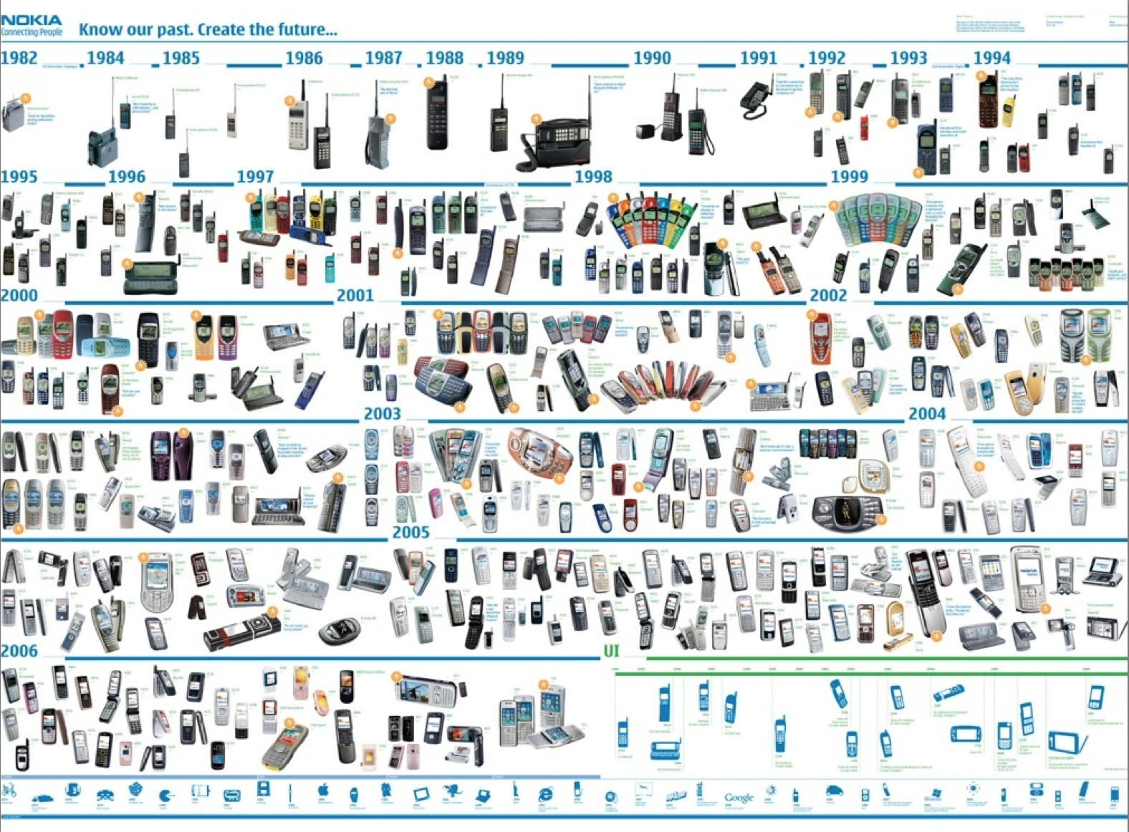





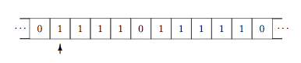
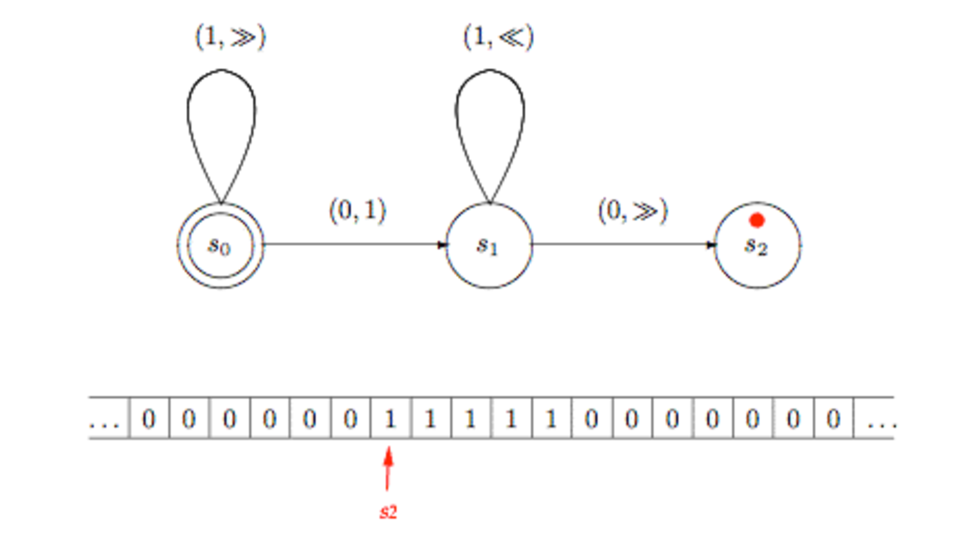
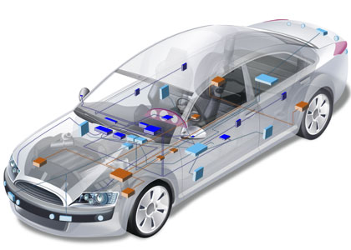

General purpose (programming) languages
Assembly COBOL Java LISP C++ PHP Scala C# Ruby Scheme Python…
17

Slide 18
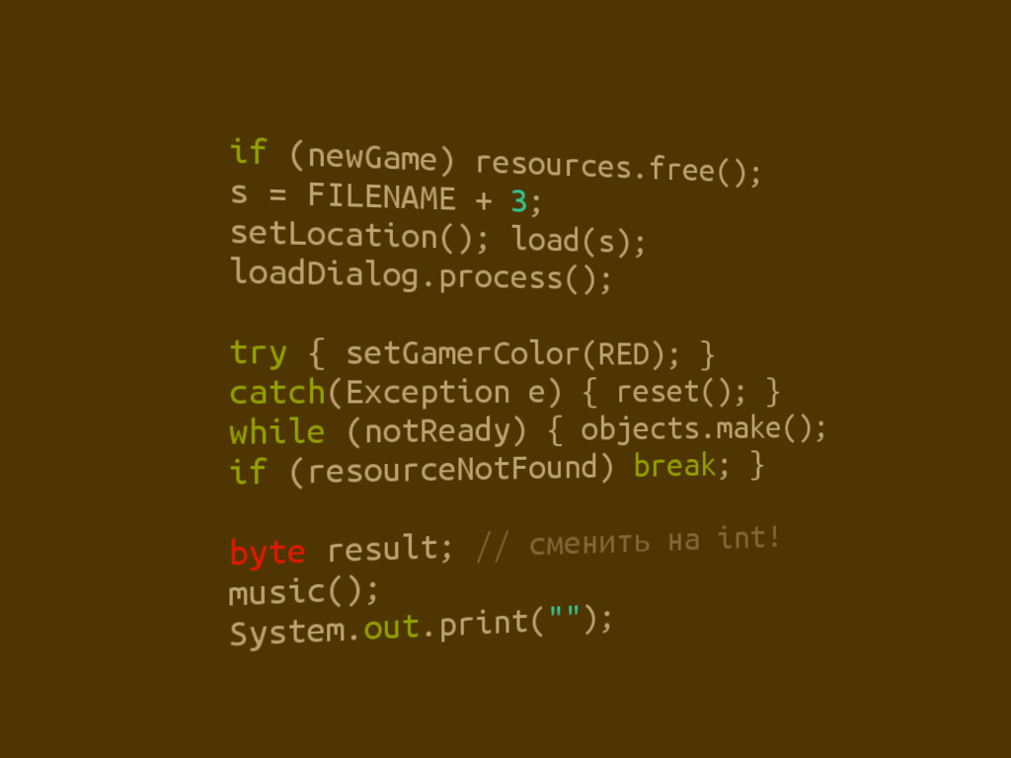



Limits of general purpose languages
Abstractions and notations are not natural/suitable for the stakeholders

Slide 19

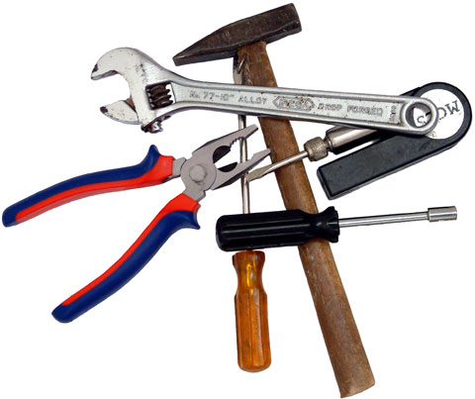
Limits of general purpose languages
Not targeted to a particular kind of problem, but to any kinds of software problem.

Slide 20
Domain-Specific Languages
Targeted to a particular kind of problem, with dedicated notations (textual or graphical), support (editor, checkers, etc.)
Promises: more efficient languages for resolving a set of specific problems in a domain
Long history: used for almost as long as computing
You’re using DSLs in a daily basis
Examples to come

Slide 21
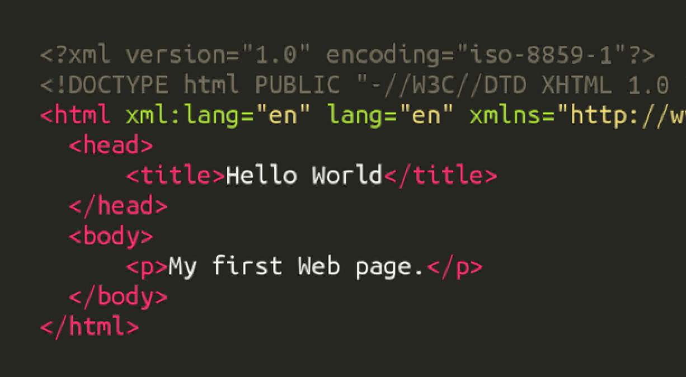
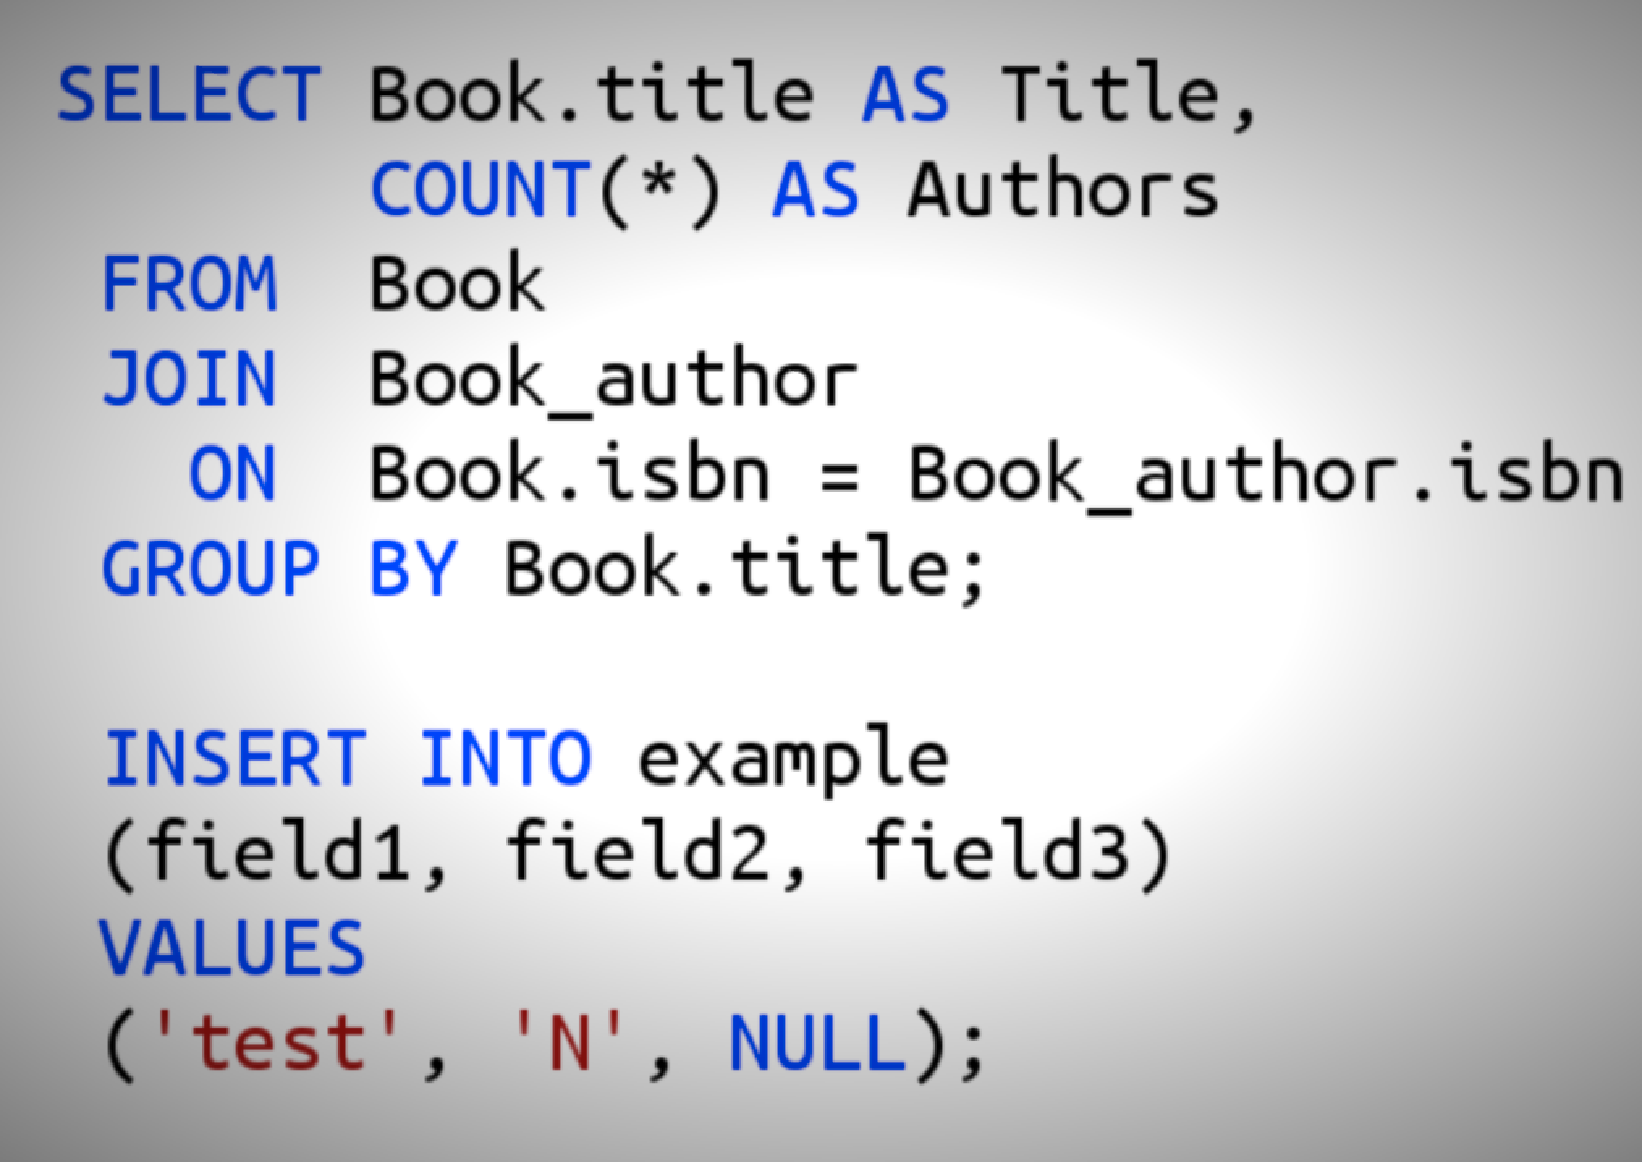
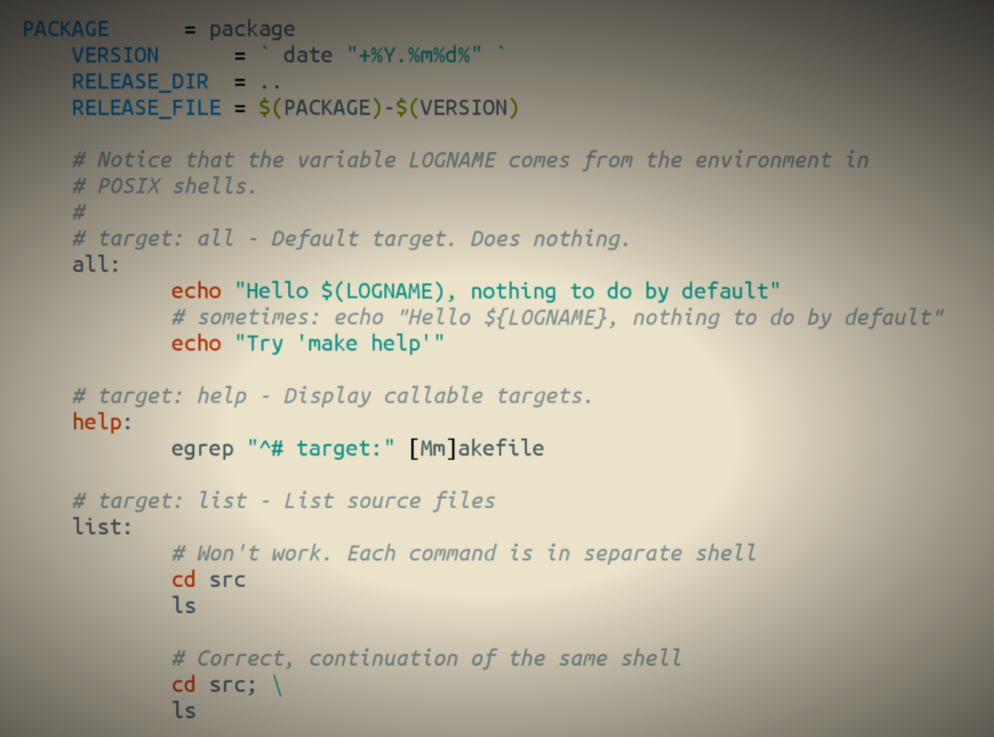
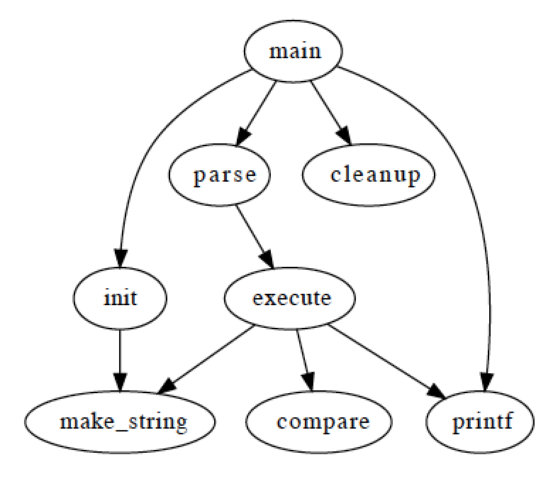
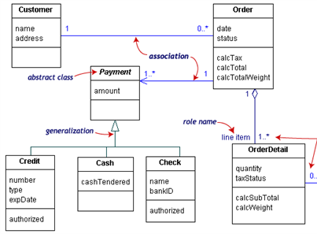
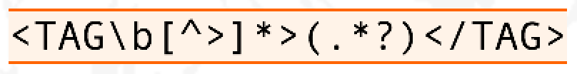
Examples
HTML
SQL
Makefile
Graphviz
Regular Expressions
UML

Slide 22
Software Language Engineering (SLE)
Application of systematic, disciplined, and measurable approaches to the development, deployment, use, and maintenance of software (domain-specific) languages
Supported by various kind of language workbenches
Eclipse EMF, xText, Sirius, Melange, GEMOC, Papyrus
Jetbrain’s MPS, MontiCore, Rascal
MS DSL Tools
etc.
Various shapes and ways to implement software languages
External, internal or embedded DSLs, Profile, etc.
Grammar, metamodel, ontology, etc.
More and more literature, a dedicated Intl. conference (ACM SLE, cf. www.sleconf.org)…

Slide 23
What are languages made of?
“The words, their pronunciation, and the methods of combining them used and understood by a community”
Concrete syntax: their words
Abstract syntax: their combination methods
Semantics: how they understood

Slide 24
Model-driven engineering (MDE)
Language Engineering
Modeling
Engineering Modeling Languages: Turning Domain Knowledge into Tools, by Benoit Combemale, Robert B. France, Jean-Marc Jézéquel, Bernhard Rumpe, Jim R.H. Steel, and Didier Vojtisek. Chapman and Hall/CRC, pp.398, 2016. Companion website: http://mdebook.irisa.fr

Slide 25
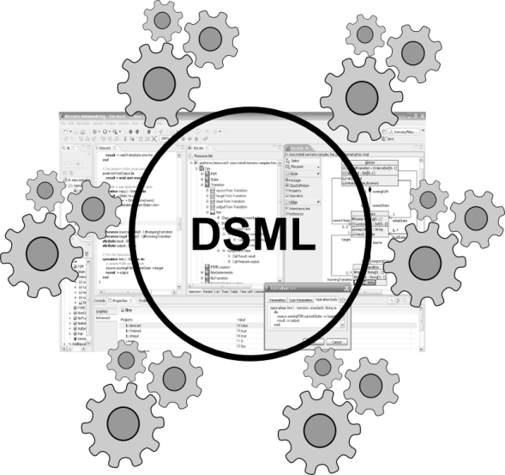
Concerns in model-driven engineering
Editors
(textual, graphical, …)
Checkers
(static & dynamics)
Compilers
Test generators
Translators
Simulators
Code generators
Analyzers
Refactoring
etc.
Engineering Modeling Languages: Turning Domain Knowledge into Tools, by Benoit Combemale, Robert B. France, Jean-Marc Jézéquel, Bernhard Rumpe, Jim R.H. Steel, and Didier Vojtisek. Chapman and Hall/CRC, pp.398, 2016. Companion website: http://mdebook.irisa.fr

Slide 26
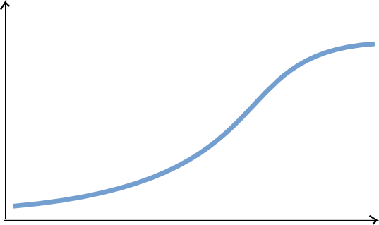
TODO: What is this slide about?
Complete environment
Large scale deployment and distribution
Rich modeling tooling
(graphical, textual, forms)
Live Collaboration (cf. Google docs)
Customizations
Large models
Parametric code generators
Documentation generators
Analysis tools
Mission critical : tested and validated!
Easy automation
Basic editing features
Reflective and dynamic editors
Classic collaboration
EMF compare
Code generation!
Environment Completeness
Lot of work
Ease of Automation
Some hours
Features
Notes:
Learning curve very flat in the beginning

Slide 27
MODEL EXECUTION
STEP 2.1

Slide 28
Eclipse as a platform
integrated development environment with base workspace and an extensible plug-in system
Contribute to existing IDE
Open structure with third party contributions
Update site, market place, …
Or create your own application
Rich Client Platform (RCP) for general purpose applications
Don’t be afraid of the number of workspace projects
Most of them are due to splitting the java packages for easier deployment and dependency management.

Slide 29
Modeling workbench vs. language workbench
We use eclipse as a language workbench in which we define the constituents of and services for languages in form of eclipse plugins.
From this we start another eclipse instance – the modeling workbench.
Into this, we deploy the tools and services to create models conforming to the language(s) defined in the language workbench.

Slide 30
2.1 Running the FSM example

Slide 31
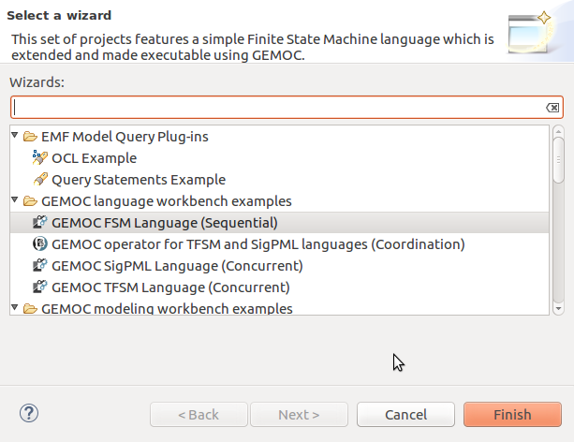
Load the FSM language
(see https://github.com/gemoc/ICSA2017Tutorial)

Slide 32
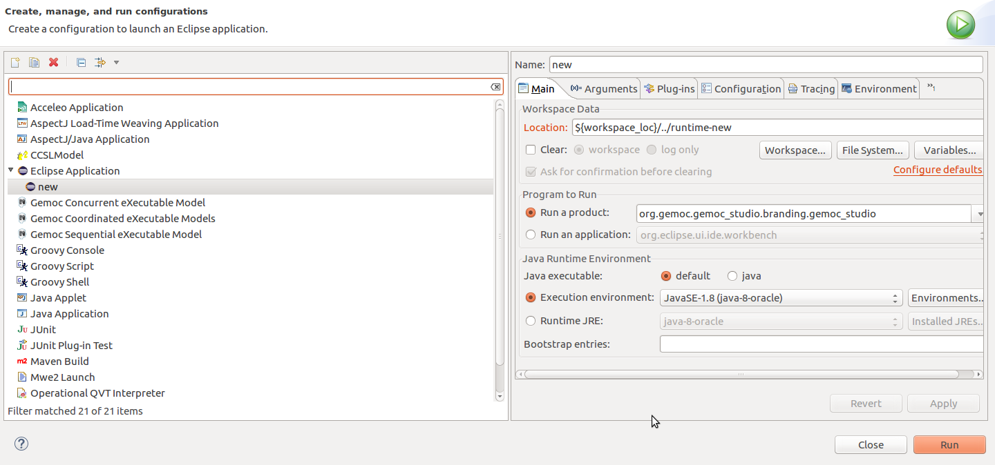
Start the modeling workbench
(see https://github.com/gemoc/ICSA2017Tutorial)

Slide 33
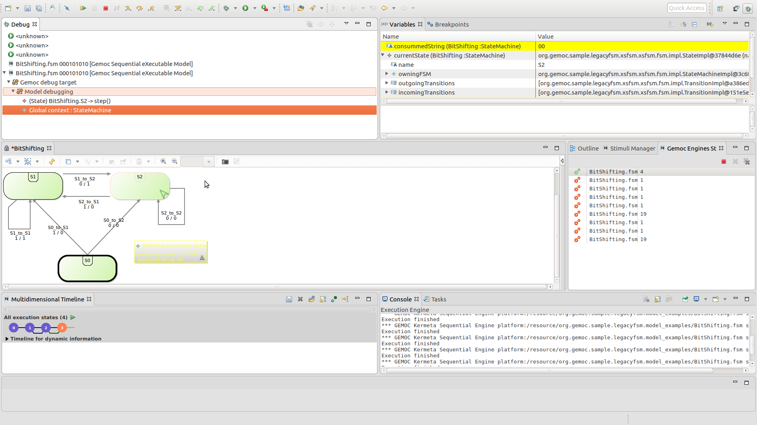
Examine and run your models
(see https://github.com/gemoc/ICSA2017Tutorial)

Slide 34
ABSTRACT SYNTAX EXTENSION
STEP 2.2

Slide 35
Abstract syntax defines your domain
We use Ecore to define the concepts and relations of the domain of FSMs
Alternatives are MOF, grammars, …
Editors
(textual, graphical, …)
Checkers
(static & dynamics)
Documentation generators
Compilers
Test generators
Translators
Simulators
Code generators
Analyzers
Refactoring
Etc.

Slide 36
Ecore/EMF
EMF serves as the foundation: It provides the Ecore meta-metamodel (basically a Class diagram ), and frameworks and tools around it :
EMF provides almost for free (among other features)
Serialization (XMI)
Tree editor
either reflective, or generated with possibility to customize
Edition support (outline, notification API for other editors, …)
Java manipulation API
EMF compatible projects use this as a base to propose extended services

Slide 37
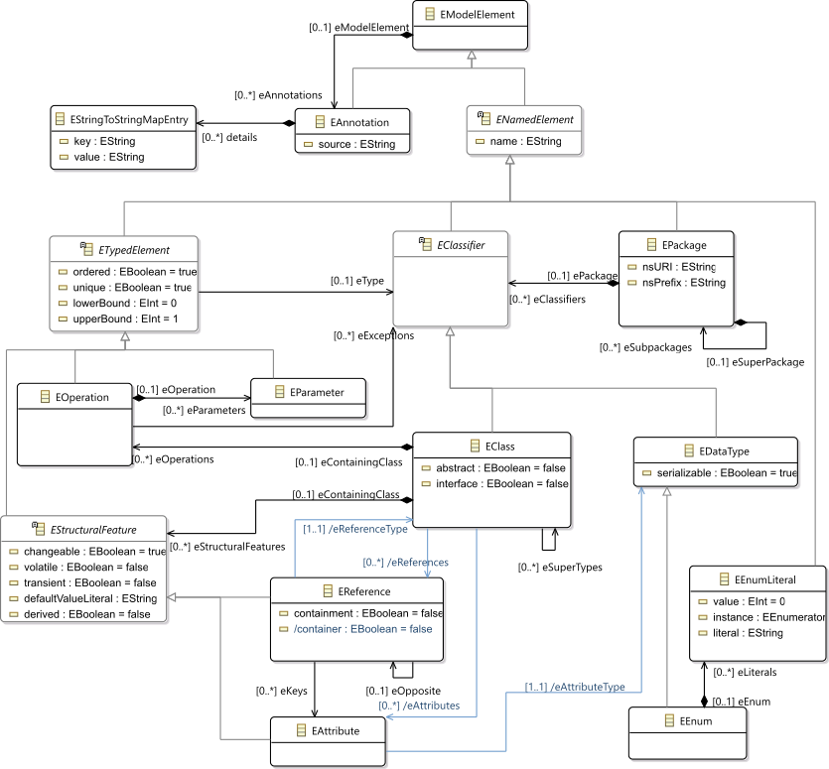
Ecore most used concepts
(removed most helper derived features, operations and generic support)

Slide 38
OCL invariants
Class diagram structure implies design choices
Invariants (e.g., in OCL) can complement it in order to enforce the consistency of models
Editors
(textual, graphical, …)
Checkers
(static & dynamics)
Documentation generators
Compilers
Test generators
Translators
Simulators
Code generators
Analyzers
Refactoring
Etc.

Slide 39
2.2 Adding new concepts to your language

Slide 40
Extend FSM abstract syntax
Add concepts for variables, guards, and actions to your FSM language
Use the graphical metamodel editor
Add an OCL invariant to your language

Slide 41
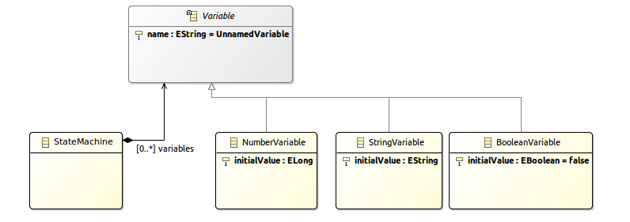
Add concept Variable
(see https://github.com/gemoc/ICSA2017Tutorial)

Slide 42
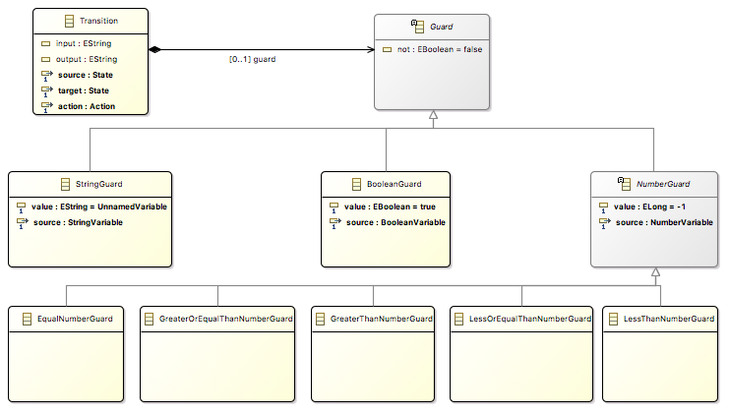
Add concept Guard
(see https://github.com/gemoc/ICSA2017Tutorial)

Slide 43
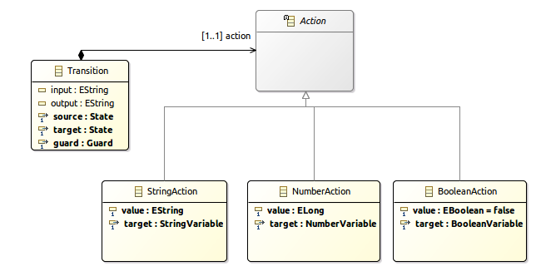
Add concept Action
(see https://github.com/gemoc/ICSA2017Tutorial)

Slide 44
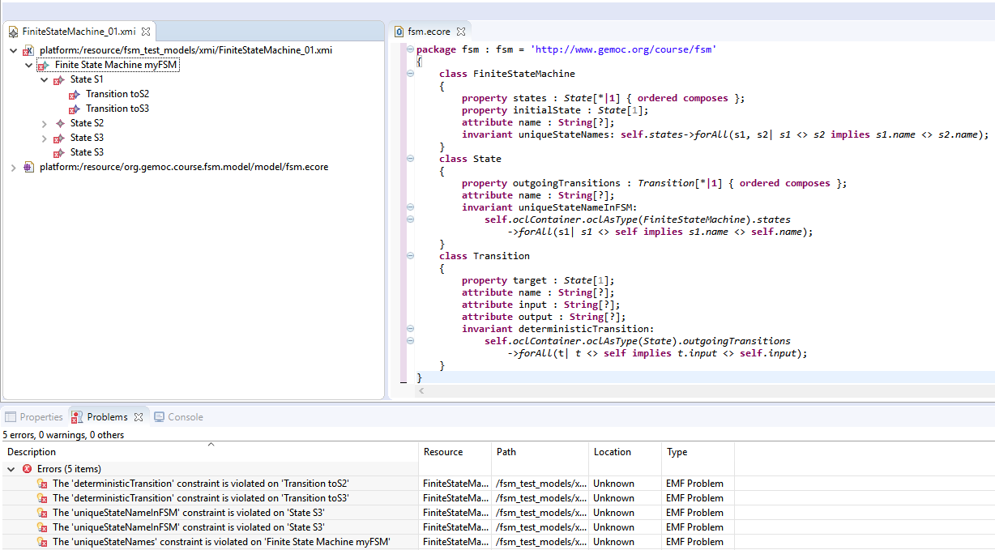
Add OCL invariant
Use the OCLInEcore editor
Add invariant: states cannot have two outgoing transitions without a guard
Syntax example: check name uniqueness
invariant uniqueStateNames:
self.states->forAll(s1, s2| s1 <> s2 implies s1.name <> s2.name);

Slide 45
DYNAMIC SEMANTICS EXTENSION
STEP 2.3

Slide 46
Adding behavior to models
Two main ways to add behavior
Operational: using interpreters
Translational: code generation
Editors
(textual, graphical, …)
Checkers
(static & dynamics)
Documentation generators
Compilers
Test generators
Translators
Interpreters
Code generators
Analyzers
Refactoring
etc.

Slide 47
Adding operational behavior to models
Usually abstract syntax traversal navigating the model
Adding operations to Ecore enables adding behavior to metamodel
but breaks separation of concerns and language reuse
Traditional approaches: visitor design pattern
However, it doesn't scale to
multiple metamodels
language composition
modular adding of new functionality

Slide 48
Meet Kermeta and Melange
Kermeta
Advanced visitor pattern with aspect oriented syntactic sugar
the programmers see the classes as if they where "reopened" and extended
Supports adding operations, attributes, associations, inheritance
@Main denotes entry points, @Step executable model parts
Melange
Language definition
Compose static metamodel (Ecore) with dynamic aspects (Kermeta) to generate a language implementation

Slide 49
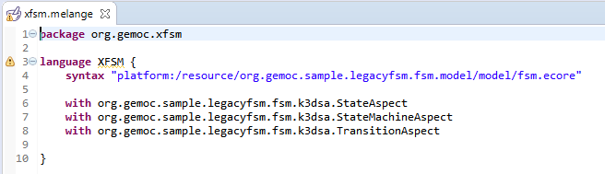
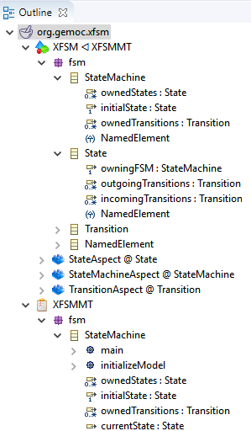
Combining language parts with Melange
xx
Adds operation and attributes
may add new concepts too by using multiple Ecore files
Melange generates the new resulting implementation

Slide 50
2.3 Completing the dynamic semantics of FSM

Slide 51
Extend FSM dynamic semantics
The FSM aspects are defined in the file tfsmAspects.xtend of project org.gemoc.sample.legacyfsm.fsm.k3dsa
Investigate these (watch for @Main and @Step)
Two methods are not implemented (marked ”TODO”): please implement these
(see https://github.com/gemoc/ICSA2017Tutorial)

Slide 52
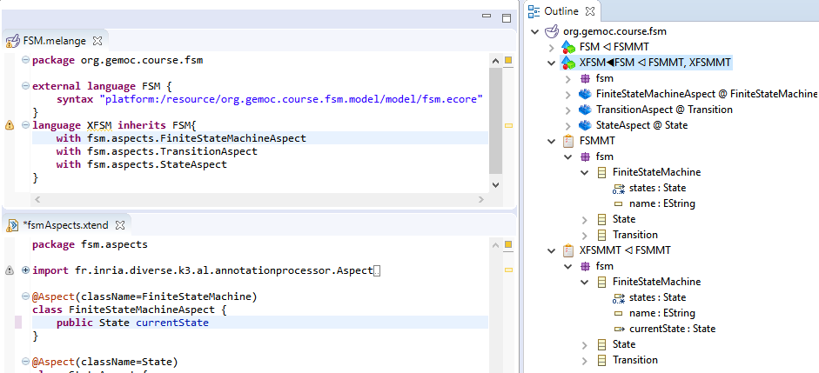
Edit Kermeta aspects
(see https://github.com/gemoc/ICSA2017Tutorial)

Slide 53

Generate executable language
(see https://github.com/gemoc/ICSA2017Tutorial)

Slide 54

Inspect woven-in operations
new operations
Check metamodel of generated project org.gemoc.sample.legacyfsm.xsfsm
(see https://github.com/gemoc/ICSA2017Tutorial)

Slide 55


Create and run extended model
(see https://github.com/gemoc/ICSA2017Tutorial)

Slide 56
Concrete syntax extension
STEP 2.4

Slide 57
Graphical concrete syntax with Sirius
Another plugin for the eclipse infrastructure
Enables creating graphical editors for ECore metamodels
Editors
(textual, graphical, …)
Checkers
(static & dynamics)
Documentation generators
Compilers
Test generators
Translators
Simulators
Code generators
Analyzers
Refactoring
etc.

Slide 58




Views for language engineers and modelers
Language engineers
Modelers
Specification environment
Runtime environment

Slide 59

Examples of viewpoints

Slide 60
Montiarc ADL
DIGRESSION

Slide 61
MontiArc¹ in a nutshell
Extensible component & connector ADL
Based on Focus semantics for distributed systems²
semantics domain are stream-processing functions
Minimal design featuring
component types and instance, component inheritance
atomic and hierarchically composed components
component interfaces of typed, directed ports
1st version: textual with MontiCore³ language workbench
Haber, A. (2016). MontiArc - Architectural Modeling and Simulation of Interactive Distributed Systems
Ringert, J. O., & Rumpe, B. (2011). A Little Synopsis on Streams, Stream Processing Functions, and State-Based Stream Processing.
Krahn, H., Rumpe, B., Völkel, S. (2008). MontiCore: Modular Development of Textual Domain Specific Languages

Slide 62
MontiArc extensions
Δ-MontiArc¹ is a DSL for expressing deltas on MontiArc component definitions, for bottom-up product lining.
MontiArcHV² allows specifying component variability fully integrated within the component hierarchy located at variation points in component definitions.
clArc³ is a variant for modeling self-replicating cloud services.
MontiArcAutomaton⁴ extends MontiArc with behavior language embedding and robotics-related modeling elements.
Haber, A., Rendel, H., Rumpe, B., Schaefer, I. (2012). Evolving Delta-oriented Software Product Line Architectures.
Haber, A., Rendel, H., Rumpe, B., Schaefer, I., van der Linden, F. (2012). Hierarchical Variability Modeling for Software Architectures.
Navarro Perez, A., Rumpe, B. (2013). Modeling Cloud Architectures as Interactive Systems.
Wortmann, A. (2016). An Extensible Component & Connector Architecture Description Infrastructure for Multi-Platform Modeling.

Slide 63

MontiArc example
CD
Garbages
Pose
ArmPose
composed
component
generic data type parameter
CD data types
subcomponent injection
CleaningRobot
MA
Garbage Detector
Garbages
ActionController<T>
ctrl
Pose
Navigation nav
FSM
Arm(Planner p)
Planner p
ArmPose
ArmCtrl
Container Checker
Int
Gripper
gr
s
T
cs
Bool
unidirectional connector between ports s and cs of type Boolean
atomic component with embedded port automaton model
subcomponent gr of type Gripper

Slide 64
XMontiArc¹
MontiArc variant for operational execution
Built on top of GEMOC Studio
Ecore metamodel
OCL static semantics
Kermeta dynamic semantics
Sirius graphical representation
Uses fixed data types (boolean, number, string)
Does not support parametrization, generics, or injection (yet)
Includes FSM language for component behavior modeling
https://github.com/awortmann/xmontiarc

Slide 65
XMontiArc Example
composed
component
CleaningRobot
XMA
Garbage Detector
Number
ActionController ctrl
Number
Navigation nav
Number
Number
FSM
Arm
Planner p
Number
ArmCtrl
Number
Container Checker
Number
Gripper
gr
Boolean
Boolean
s
cs
unidirectional connector between ports s and cs of type Boolean
atomic component with embedded port automaton model
subcomponent gr of type Gripper

Slide 66
XMontiArc Example
composed
component
CleaningRobot
XMA
Garbage Detector
Number
ActionController ctrl
Number
Navigation nav
Number
Number
FSM
Arm
Planner p
Number
ArmCtrl
Number
Container Checker
Number
Gripper
gr
Boolean
Boolean
s
cs
unidirectional connector between ports s and cs of type Boolean
atomic component with embedded port automaton model
subcomponent gr of type Gripper
Graphical representation of intermediate connectors
Embedding of FSM for component behavior

Slide 67
2.4 Concrete graphical syntax with Sirius

Slide 68
Extend MontiArc concrete syntax
Define the graphical representation of IntermediateConnector instances in the model.
Define what you have to draw and configure when you add a new IntermediateConnector to the diagram.
(see https://github.com/gemoc/ICSA2017Tutorial)

Slide 69
Load graphical representation of BumperBot architecture model
TODO: Add screenshot
(see https://github.com/gemoc/ICSA2017Tutorial)

Slide 70

Add connector representation
(see https://github.com/gemoc/ICSA2017Tutorial)

Slide 71

Add a new creation action
(see https://github.com/gemoc/ICSA2017Tutorial)

Slide 72
Language composition
STEP 2.5

Slide 73
XMontiArc Final Project Structure (TODO)
static metamodels
≪ecore≫
MontiArc Model
≪ecore≫
FSM Model
≪K3≫
XMontiArc K3DSA
executable DSML through weaving
≪K3≫
XSFSM K3DSA
≪melange≫
XMontiArc XDSML
≪melange≫
XSFSM XDSML
aspects defining dynamic semantics
≪melange≫
XMontiArcWithAutomaton XDSML
XMontiArc XMontiArc
XSFSM XSFSM
generated language implementation
XMontiArcWithAutomaton XMontiArc
XMontiArcWithAutomaton XMontiArcWithAutomaton
XMontiArcWithAutomaton XSFSM

Slide 74
2.5 Compose MontiArc & FSM

Slide 75
TODO
tbc
(see https://github.com/gemoc/ICSA2017Tutorial)

Slide 76
WRAP-UP and Discussion
PART 3

Slide 77
Take-away messages
DSLs are important (as intuited for a long time – it will become more and more apparent)
DSL technology is here and ready to use
Over 30 language workbenches in the wild (cf. http://2016.splashcon.org/track/lwc2016)
Software language engineering is maturing to support MDE

Slide 78
Wrap-up and discussion
Today you have
executed models of the FSM language
extended its Ecore metamodel with new variables, guards, and transitions
restricted it using OCL well-formedness rules
augmented its dynamic semantics to consider the new modeling elements using Kermeta
extended its concrete graphical syntax and editor using Sirius
combined two modeling languages to produce executable architecture models using Melange
We hope you enjoyed it and are consider building your own DSLs where appropriate
Before you leave: please answer six questions: https://goo.gl/NKZLAF

Slide 79
Thank you
The End

